Slide 1
MER301: Advanced Strength of Materials
Superposition and Beam Bending Tables
Moment Area Methods

Slide 2
Superposition
A
B
C
D
A
B
C
D

Slide 3
Rules to Solve Problems Method of Superposition
Decompose the statically indeterminate problem into two (or more statically determinate problems.
Assumptions
The loading must be linearly related to the stress or displacement that is to be determined
The loading must not significantly change the original geometry of the configuration or configuration of the member

Slide 4
Superposition Method Procedure
Relieve the redundant constraint in the structure
Determine this structures static reaction
Remove all external applied loads on the original structure and apply the redundant constraint as a pseudo-force.
The solution of the original problem is arrived at by superimposing the solution from the preceding two parts through a constraint Equation

Slide 5
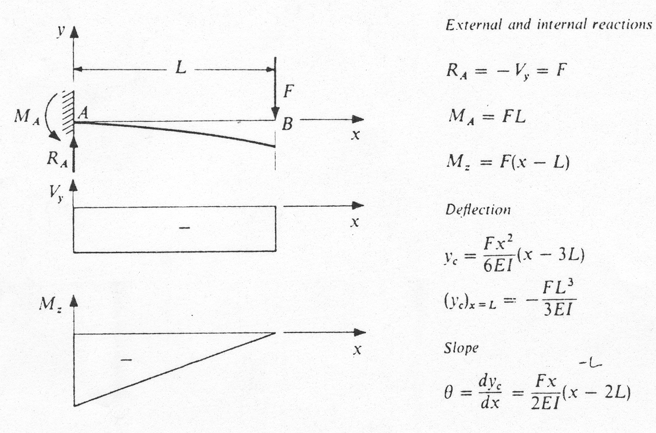
Cantilever with End Load

Slide 6
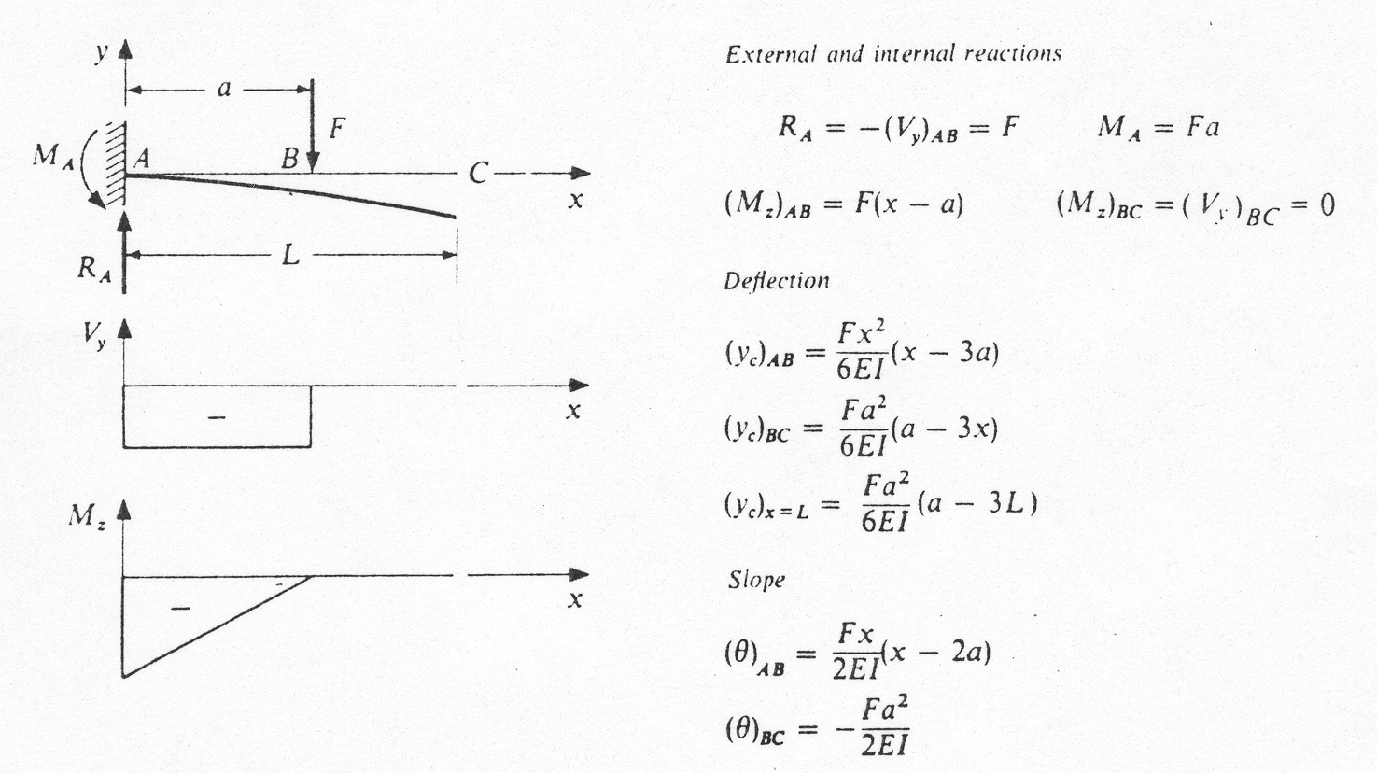
Cantilever with Intermediate Load

Slide 7
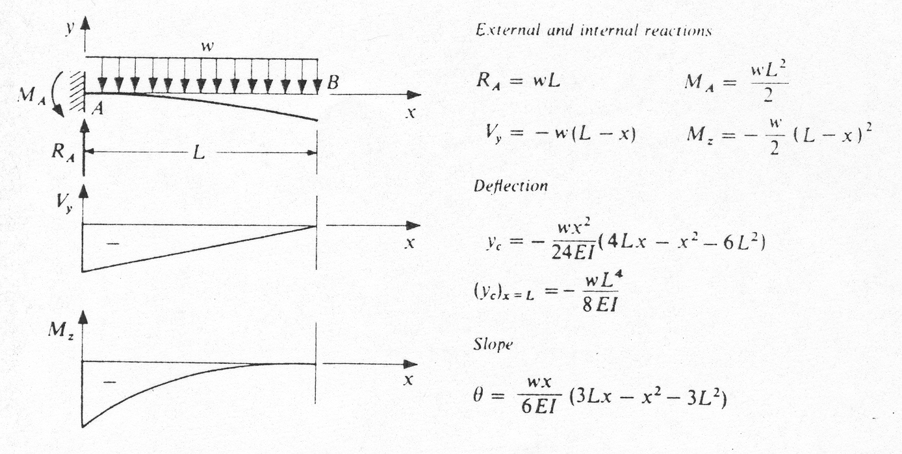
Cantilever with Uniform Load

Slide 8
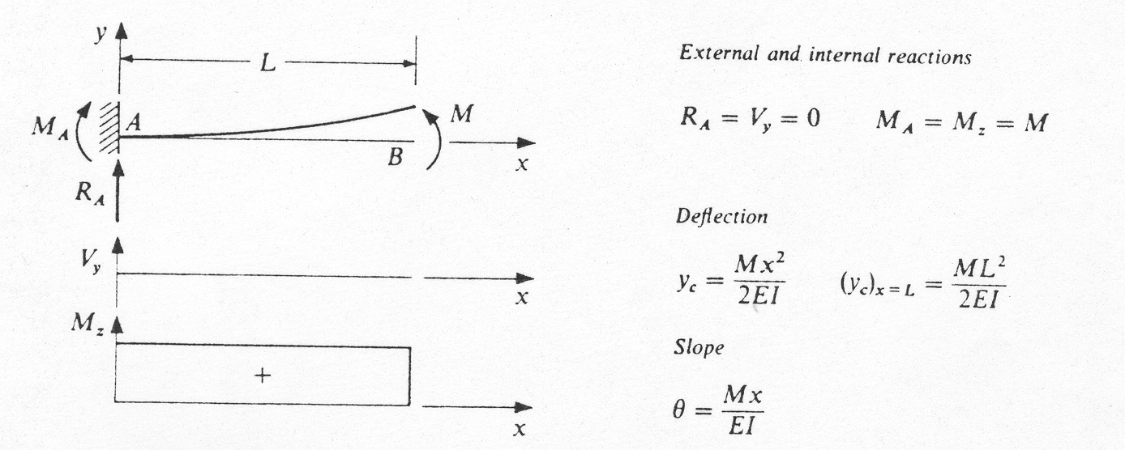
Cantilever with Moment Load

Slide 9
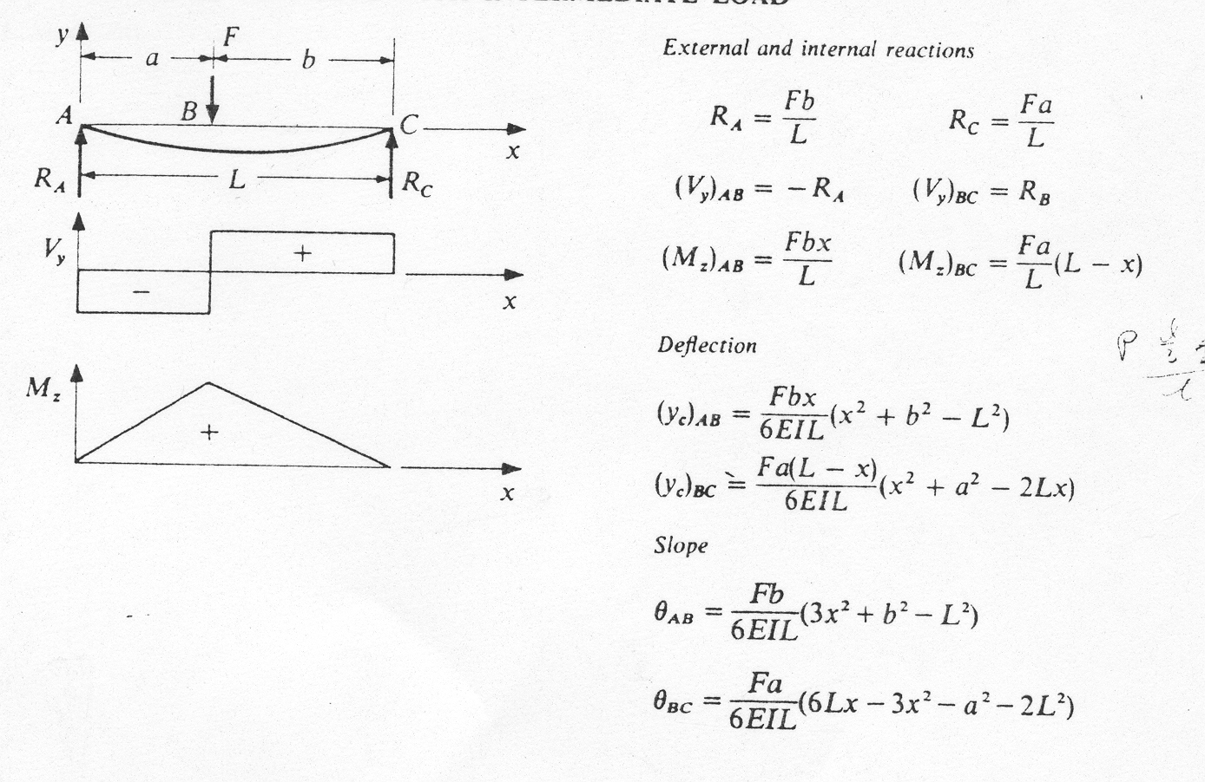
Simple Supports with Intermediate Load

Slide 10
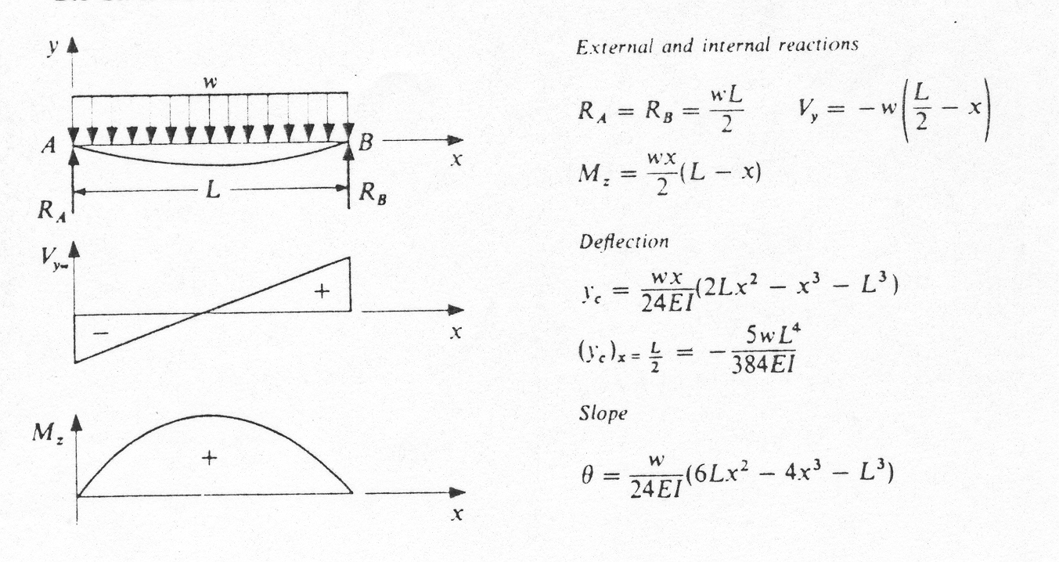
Simple supports with Uniform Load

Slide 11
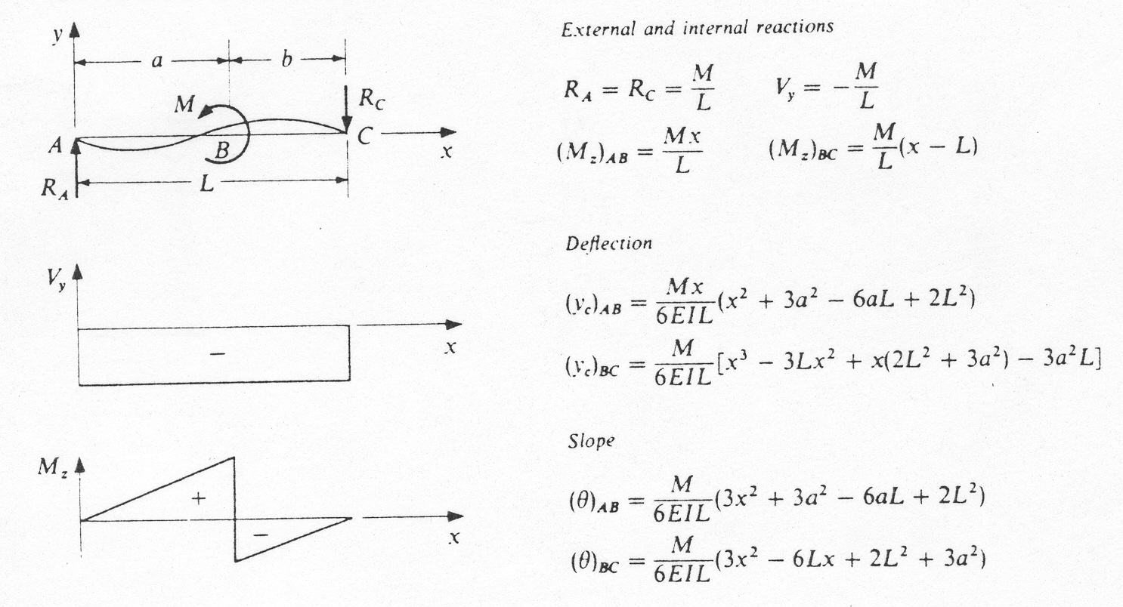
Simple Supports with Moment Load

Slide 12
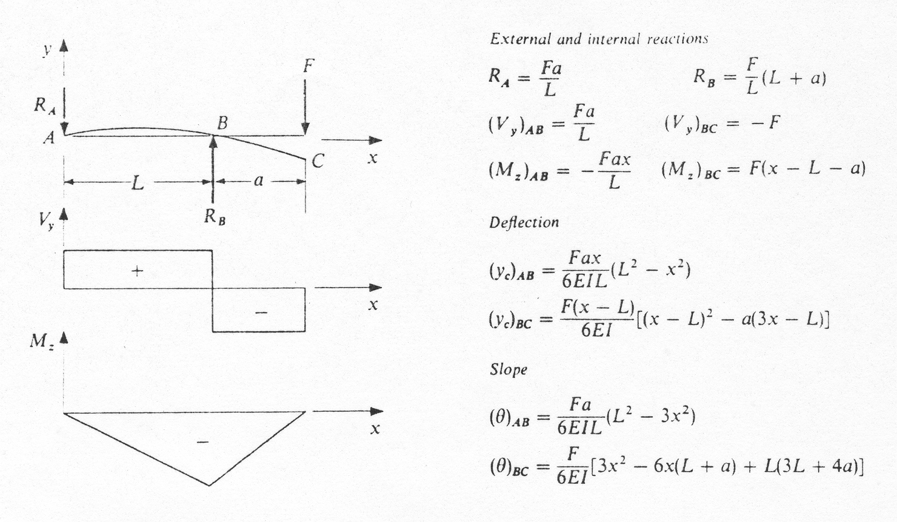
Simple Supports with Overhanging Load

Slide 13
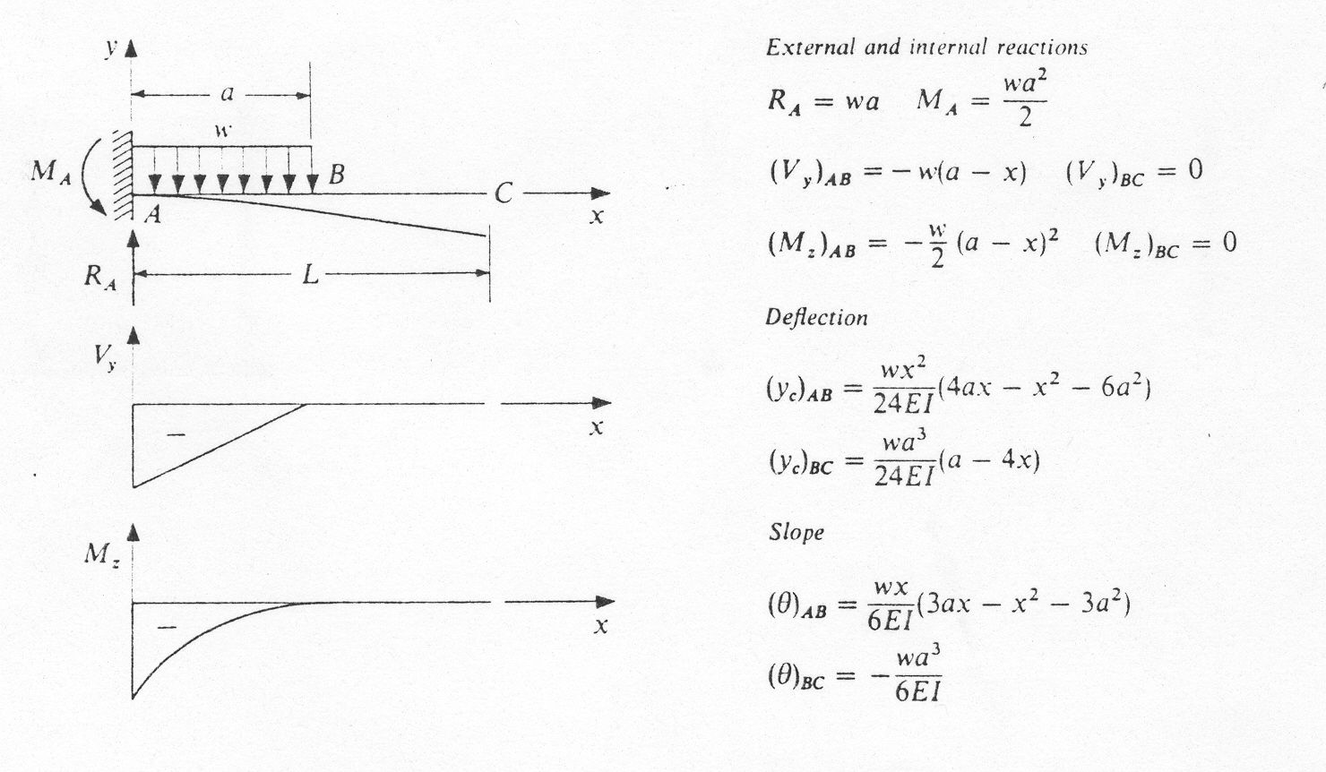
Cantilever with Partial Distributed Load

Slide 14
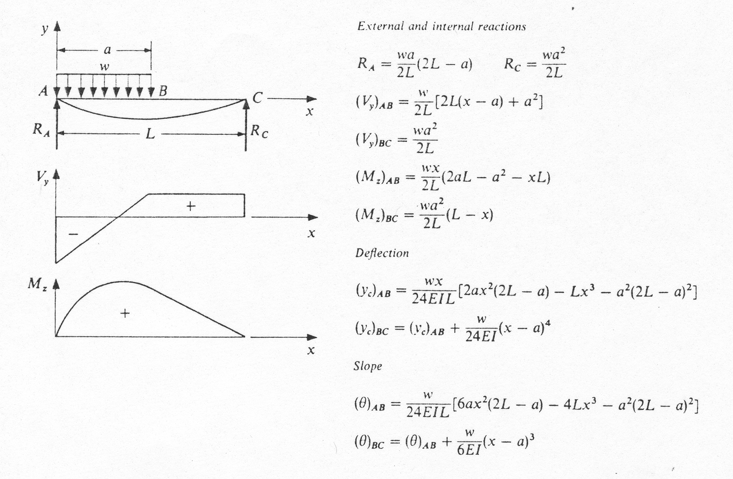
Simple Supports with Partial Distributed Load

Slide 15
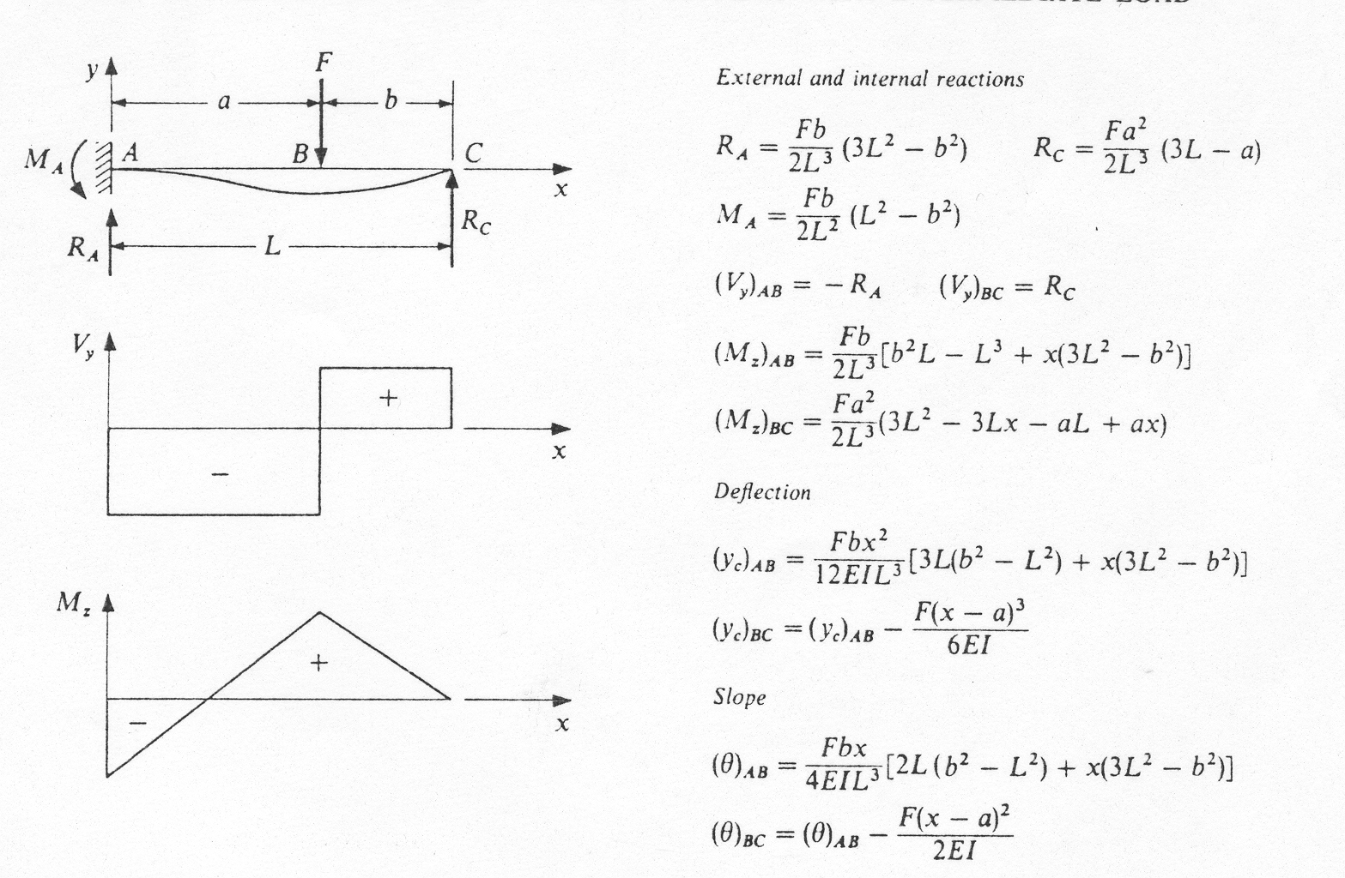
One End Fixed and One Simple Support with Intermediate Load

Slide 16
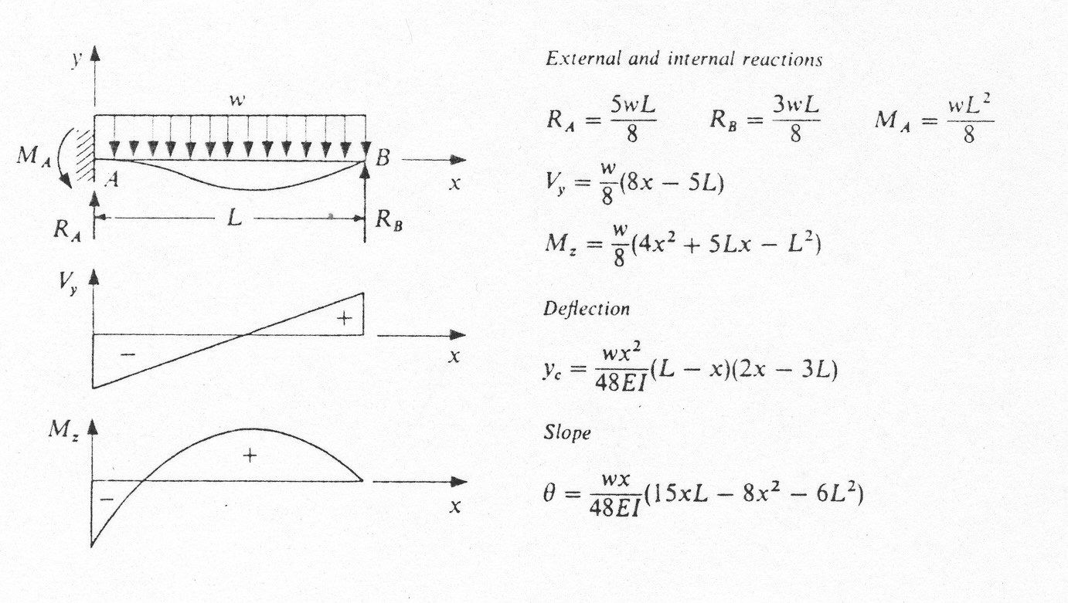
One end Fixed and One Simple Support with Uniform Load

Slide 17
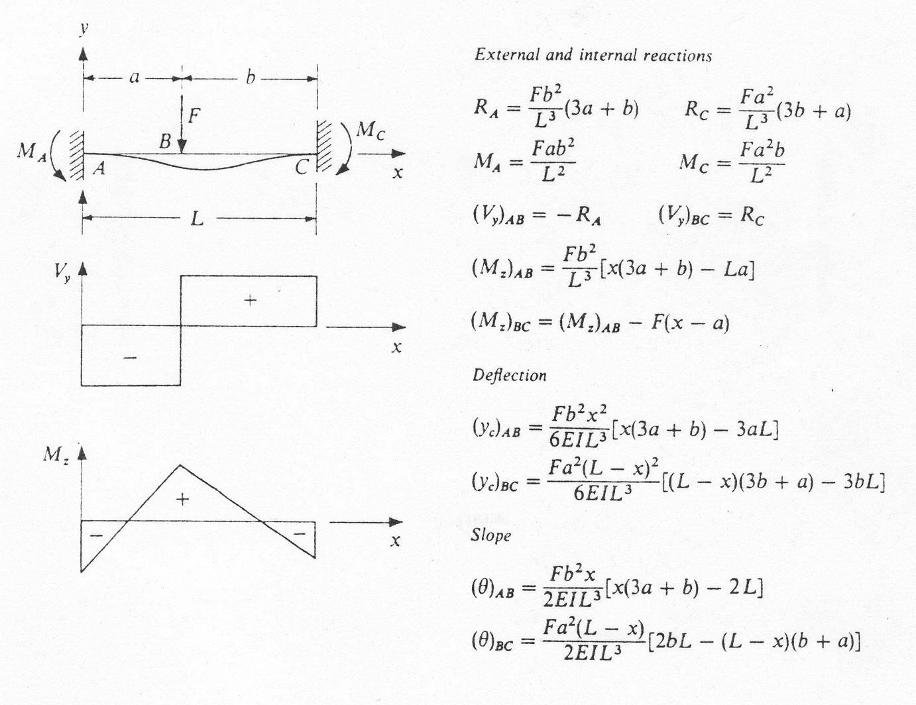
Fixed Supports with Intermediate Load

Slide 18
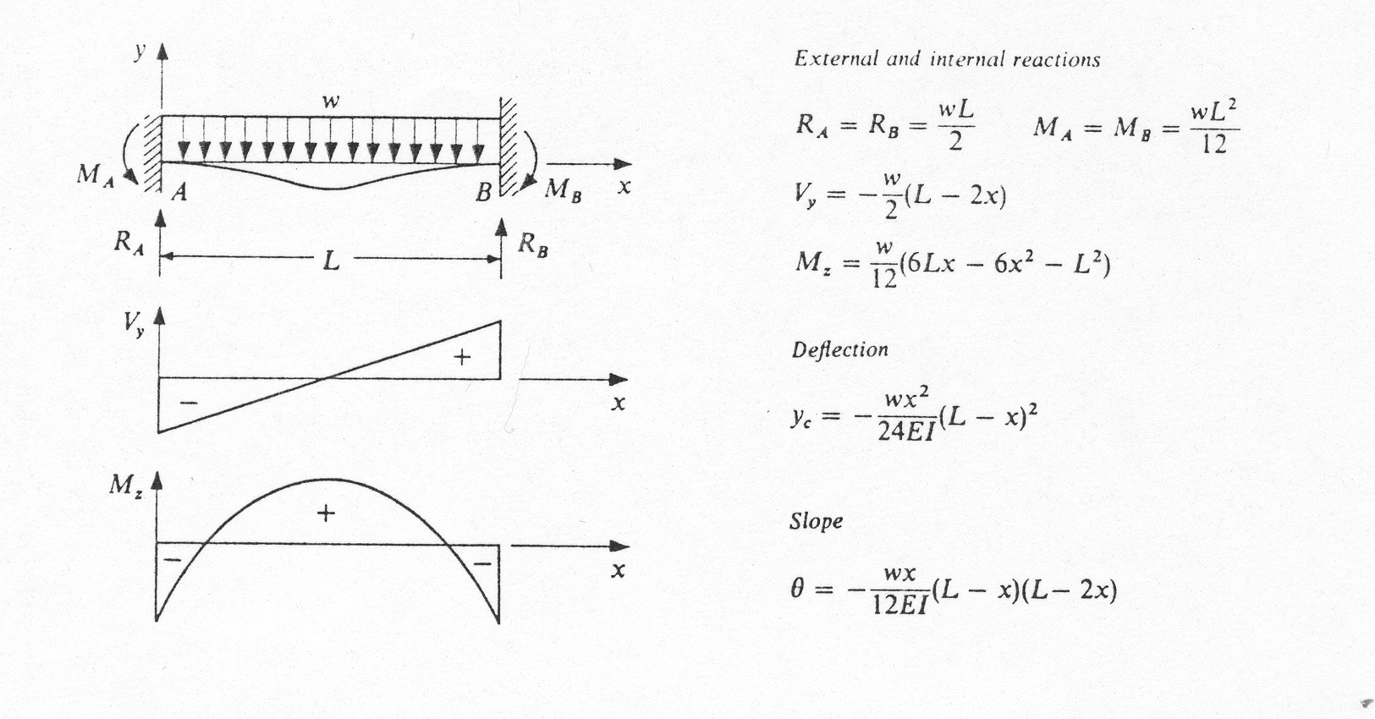
Fixed Supports with Uniform Load

Slide 19
Moment Area Method Theorem I
This area is equal to the change in angle between two adjoining tangents

Slide 20
Example

Slide 21
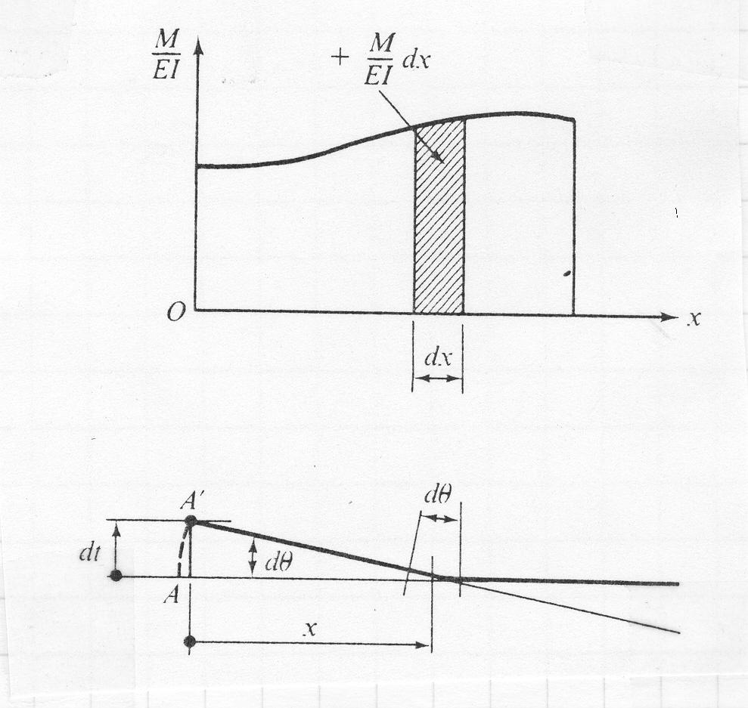
Moment Area Method Theorem I
The angle between the tangents at any two points on the elastic curve equals the area under the M/EI diagram between these points

Slide 22
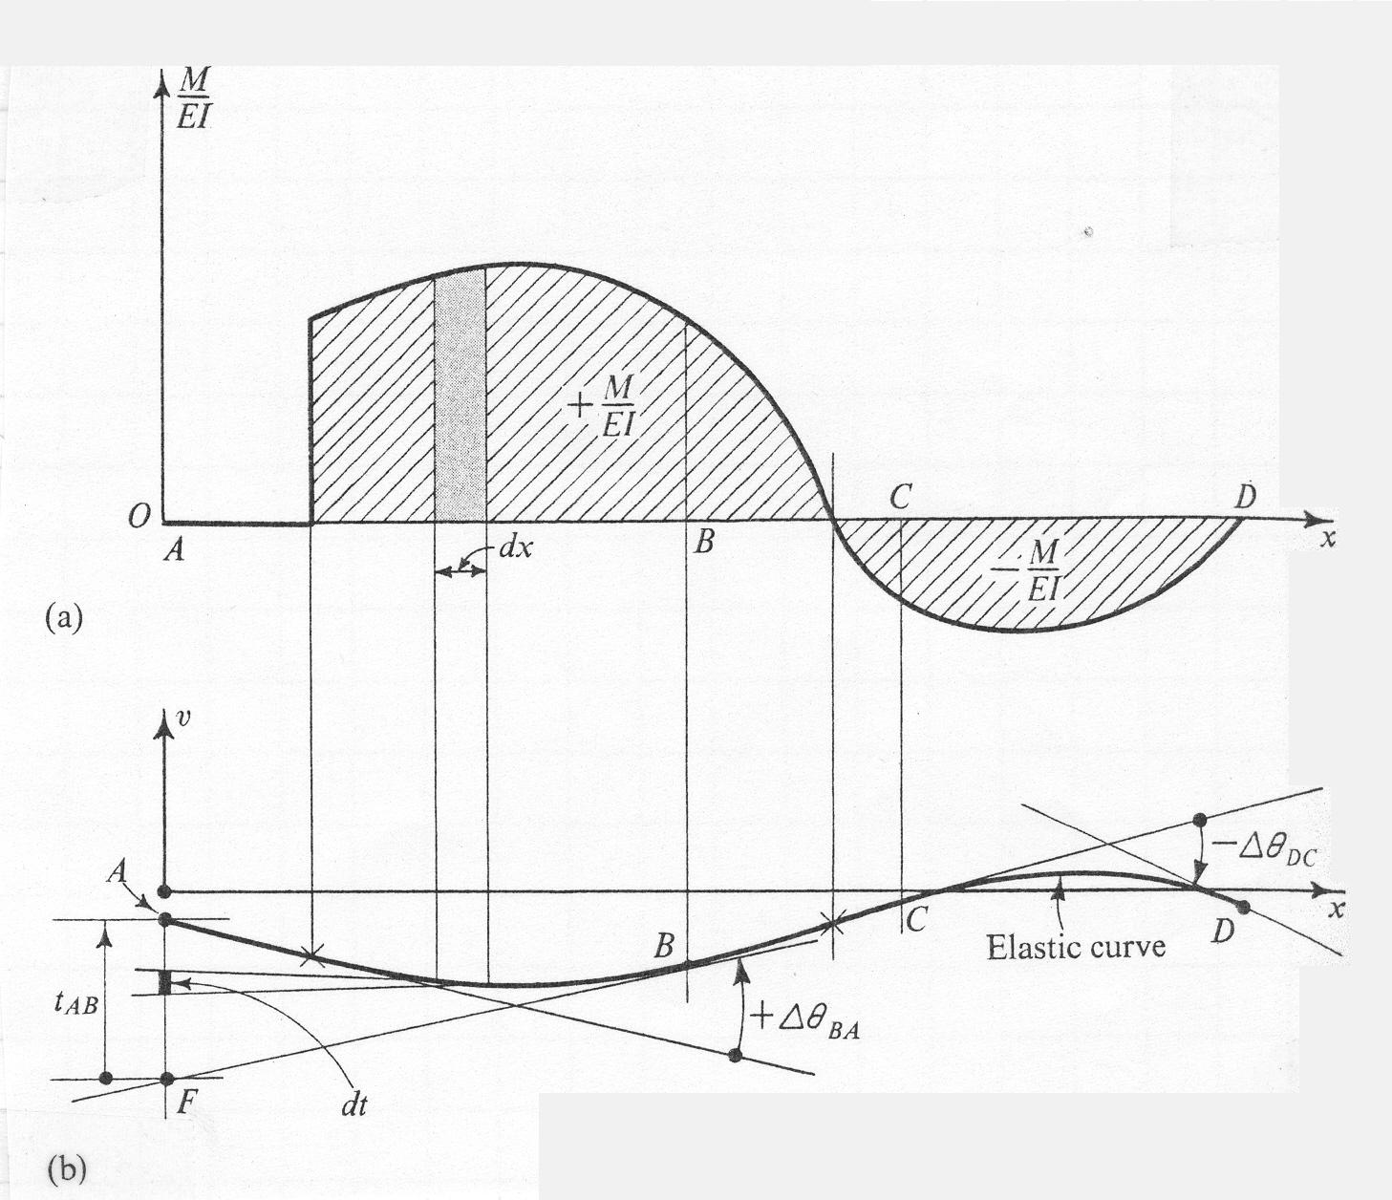
Graphical Illustration

Slide 23
Moment Area Method Theorem II

Slide 24
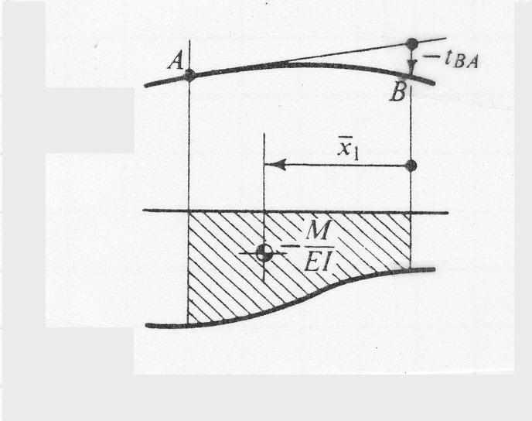
Moment Area Method Theorem II
The vertical deviation of the tangent at jpoint A on the elastic curve with respect to the tangent extended from another point B equals the moment of the area under the M/EI diagram between the two points (A and B). This moment is computed about a vertical axis passing through the point (A) where the vertical deviation (t_{a/b}) is to be determined.

Slide 25
Some Areas and Centroids for Common Shapes
Shape
Area
c
b
c
Rectangle
bh
b/2
h
b
c
Triangle
bh/2
b/3
h

Slide 26
Areas and Centroids for Shapes Commonly Incountered in Beams
Shape
Area
c
Parabolic
Spandrel
y=kx²
c
bh/3
b/4
Cubic
Spandrel
h
y=kx³
bh/4
b/5
b
General
Spandrel
y=kx^{n}
bh/(n+1)
b/(n+2)

Slide 27
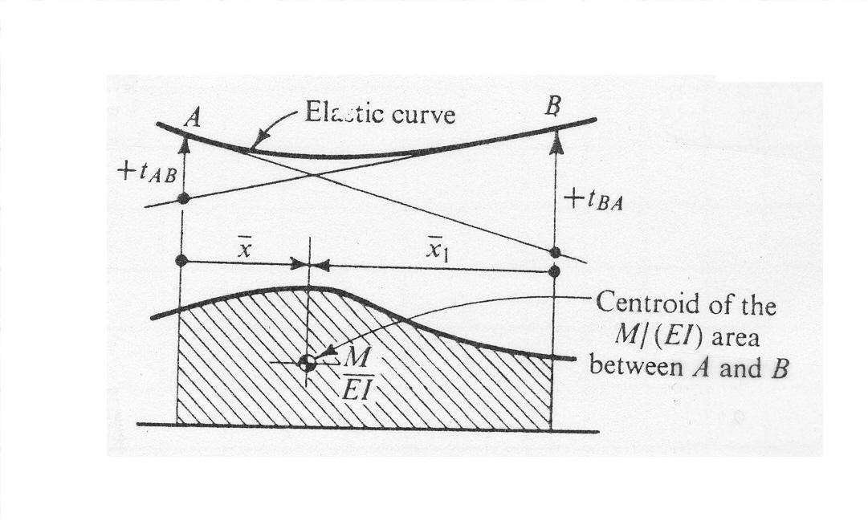
Illustration

Slide 28
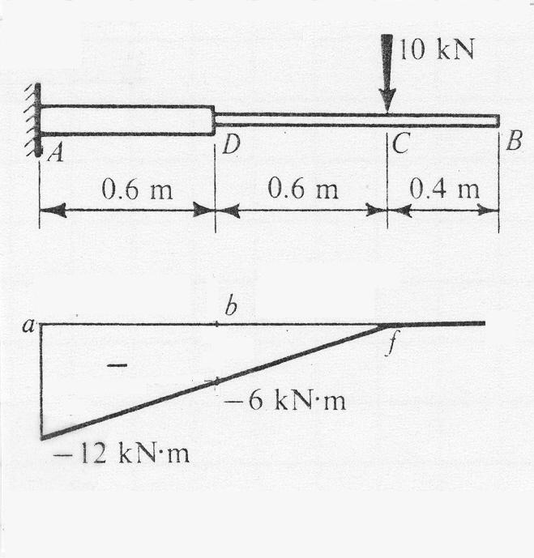
Example 1
Consider an aluminum cantilever beam 1.6m long with a 10kN force applied 0.4m from the free end, the beam is of greater depth than it is beyond, having I₁=5x10⁻⁴ m⁴. For the remaining 1 m of the beam, I₂=1x10⁻⁴ m⁴. Find the deflection and the angular rotation of the free end. Neglect the weight of the beam, and assume E for aluminum at 70(10⁹) N/m²

Slide 29
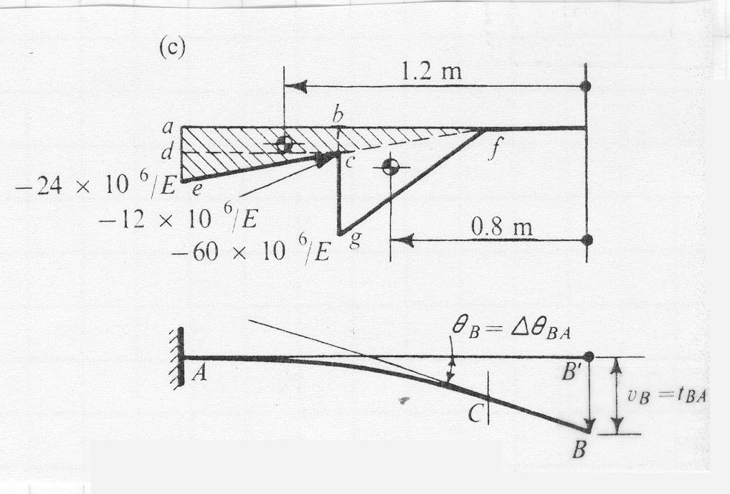
Example 1: Illustration

Slide 30
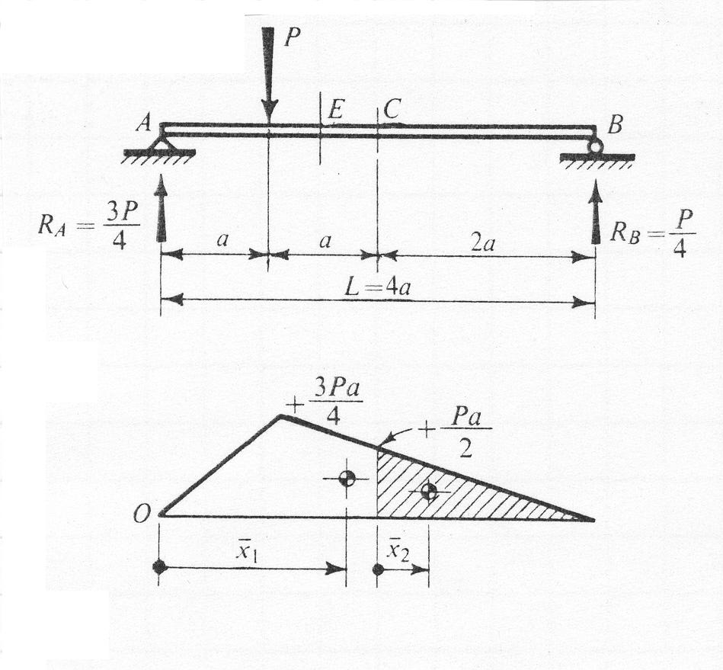
Example 2
Find the deflection due to the concentrated force P applied as shown in the figure at the center of the simply supported beam. The flexural rigidity EI is constant.

Slide 31
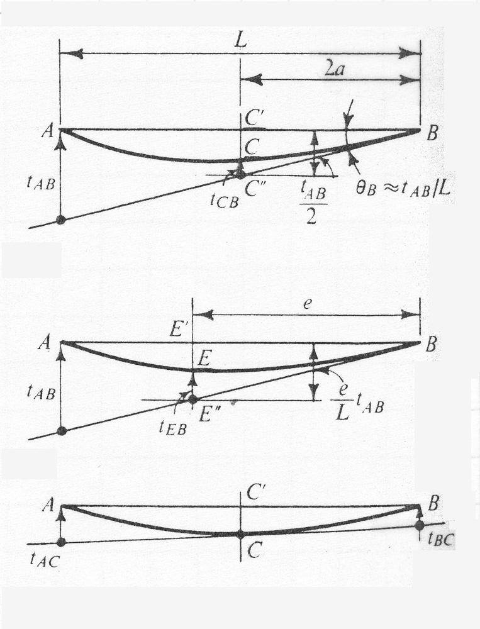
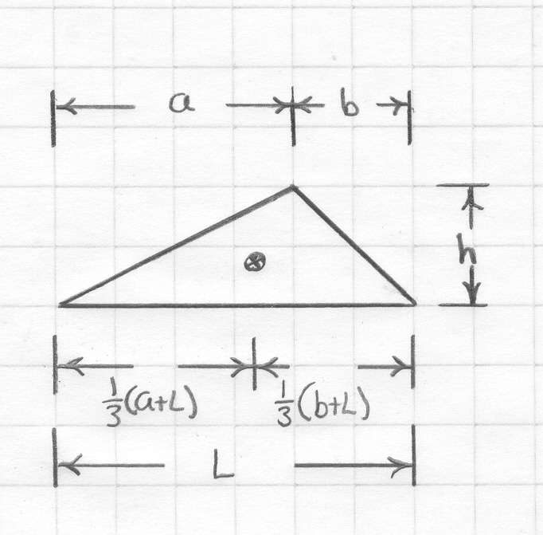
Example 2: Illustration

Slide 32
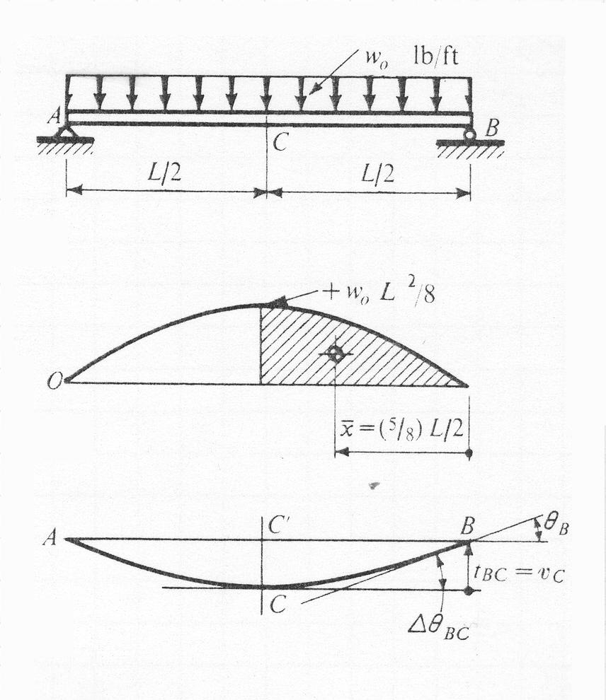
Example 3
In a simple supported beam, fined the maximum deflection and rotations of the elastic curve at the ends caused by the application of a uniformly distributed load of w_{o} lb/ft.

Slide 33
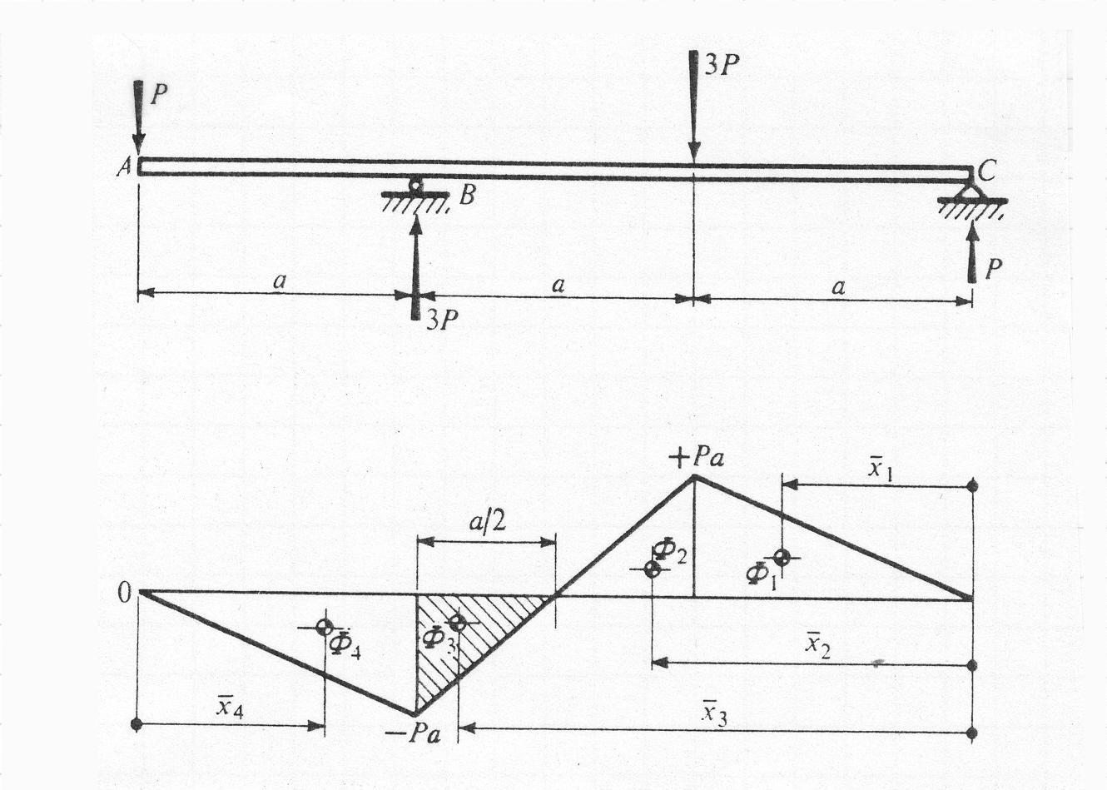
Example 4
Determine the deflection of the free end at A

Slide 34
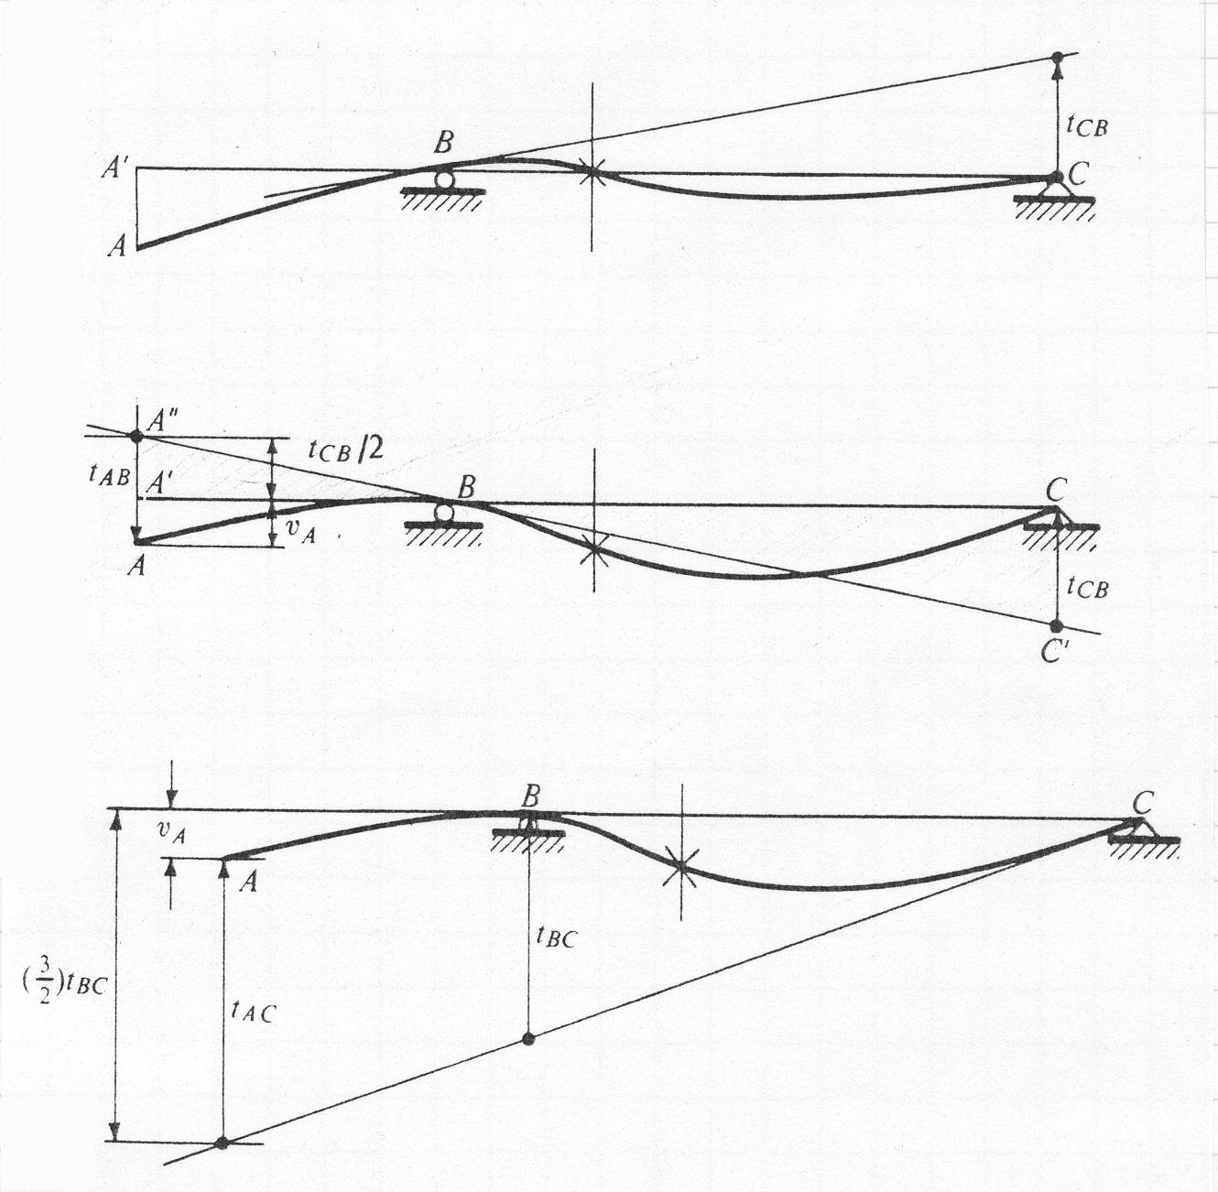
Illustration for Example 4

